Slide 1
Unit 1
Hello
Lesson 2
Teacher: Ms Thom

Slide 2
Vocabulary
Goodbye
/ˌɡʊdˈbaɪ/
Bye
Class
/baɪ/
/klɑːs/

Slide 3
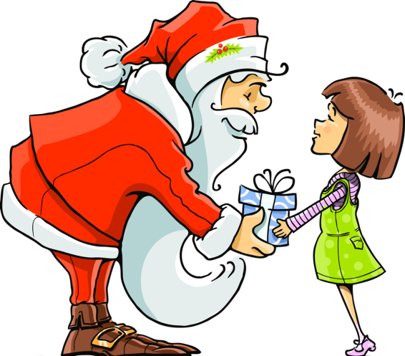
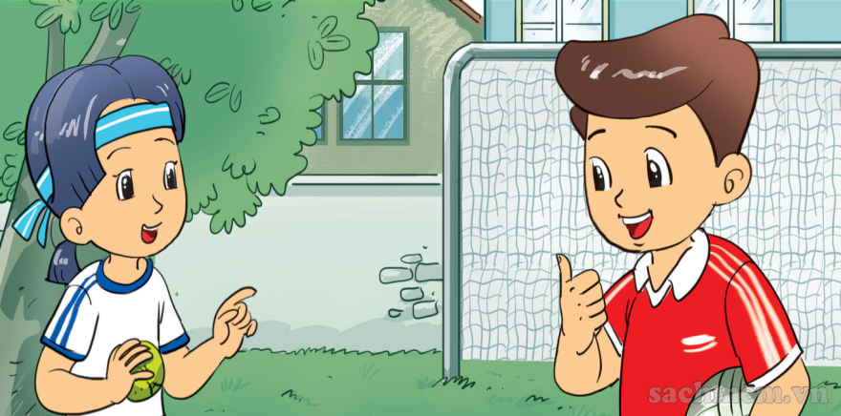
Vocabulary
Thank you
/ θæŋk juː/
Fine
/faɪn/
Thanks
/ θæŋks/
And
How are you?
ænd
/haʊ ɑː juː/

Slide 4
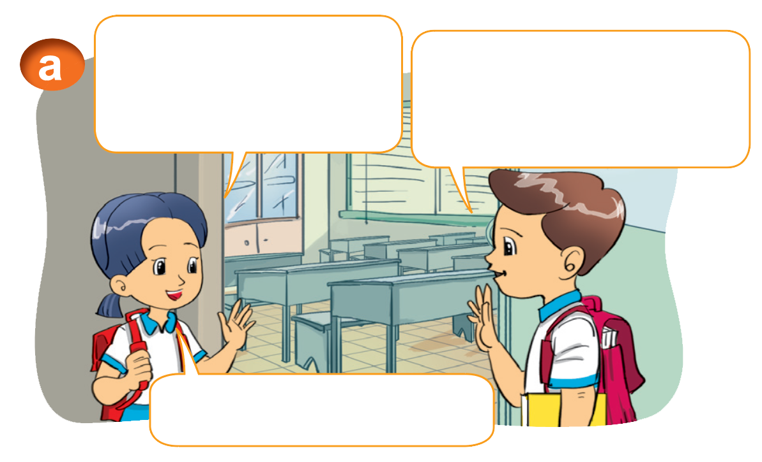
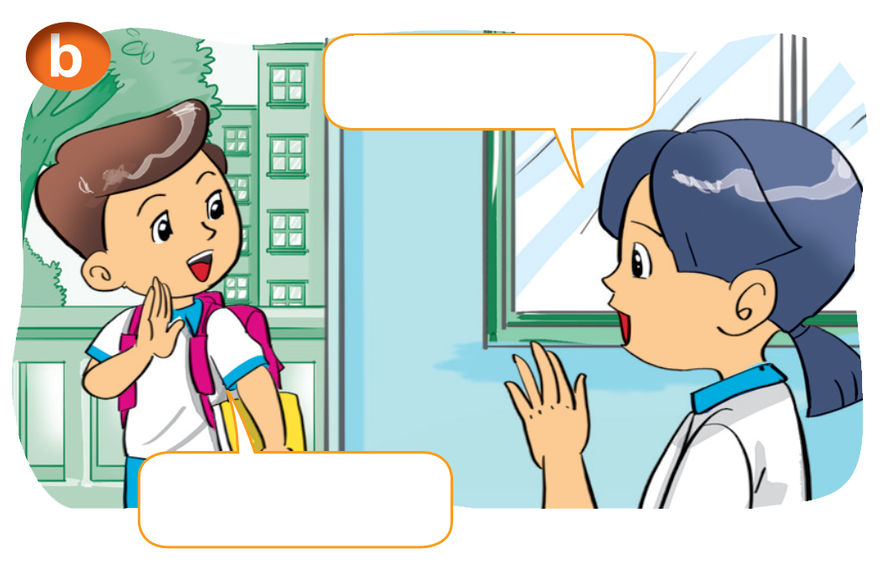
1. Look, listen and repeat
Hi, Nam. How are you?
I'm fine, thanks. And you?
Bye, Nam.
Fine, thank you.
Bye, Mai.

Slide 5
2. Point and say.
Fine, thanks. And you?
How are you, ______.
Nam
Fine, thank you.

Slide 6
Structure
Hỏi tình hình sức khỏe:
How are you? (Bạn có khỏe không?)
I'm fine. Thank you. And you?
(Mình khỏe. Cảm ơn. Còn bạn thì sao?)

Slide 7
Practise

Slide 8
2. Point and say.
Fine, thanks. And you?
How are you, _______.
Phong
Fine, thank you.

Slide 9
3. Let’s talk.
How are you, Phong?
I'm fine, thank you. And you?
I'm fine, thank you.

Slide 10
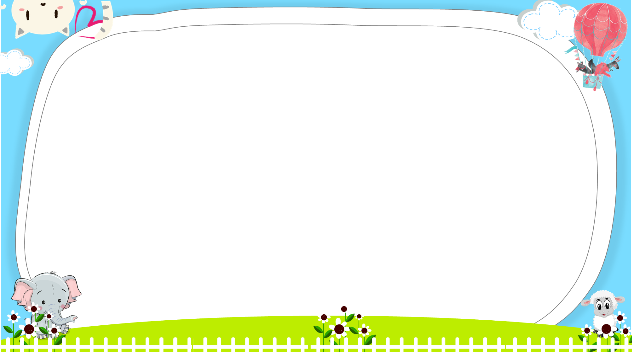
AND
GAME
PLAY
Notes:
Ms Huyền Phạm - 0936.082.789 – YOUTUBE: MsPham. Facebook: Dạy và học cùng công nghệ.

Slide 11
Look and tick
How are
you?
Thank you!
____
Next
Notes:
Ms Huyền Phạm - 0936.082.789 – YOUTUBE: MsPham. Facebook: Dạy và học cùng công nghệ.

Slide 12
Look and tick
Thank you
Goodbye
Next
Notes:
Ms Huyền Phạm - 0936.082.789 – YOUTUBE: MsPham. Facebook: Dạy và học cùng công nghệ.

Slide 13
Look and tick
Fine
Hello
Next
Notes:
Ms Huyền Phạm - 0936.082.789 – YOUTUBE: MsPham. Facebook: Dạy và học cùng công nghệ.

Slide 14
Look and tick
Thanks
And
_____
Next
Notes:
Ms Huyền Phạm - 0936.082.789 – YOUTUBE: MsPham. Facebook: Dạy và học cùng công nghệ.

Slide 15
Look and tick
Class
Bye
Next
Notes:
Ms Huyền Phạm - 0936.082.789 – YOUTUBE: MsPham. Facebook: Dạy và học cùng công nghệ.

Slide 16
Look and tick
five
fine
How are you, Miss Amy?
I'm ______, thank you. And you?
I'm fine, thank you.
Next
Notes:
Ms Huyền Phạm - 0936.082.789 – YOUTUBE: MsPham. Facebook: Dạy và học cùng công nghệ.

Slide 17
Look and tick
How are you
Hello
______________, Phong?
I'm fine, thank you. And you?
I'm fine, thank you.
Next
Notes:
Ms Huyền Phạm - 0936.082.789 – YOUTUBE: MsPham. Facebook: Dạy và học cùng công nghệ.

Slide 18
Look and tick
Nice
I’m
How are you, Quan?
______ fine, thank you. And you?
I'm fine, thank you.
Next
Notes:
Ms Huyền Phạm - 0936.082.789 – YOUTUBE: MsPham. Facebook: Dạy và học cùng công nghệ.

Slide 19
Look and tick
thanks
Hi
How are you, Miss Hien?
I'm fine, _______. And you?
I'm fine, thank you.
Next
Notes:
Ms Huyền Phạm - 0936.082.789 – YOUTUBE: MsPham. Facebook: Dạy và học cùng công nghệ.

Slide 20
Look and tick
And you
And
How are you, Miss Ha?
I'm fine, thank you. _______?
I'm fine, thank you.
Next
Notes:
Ms Huyền Phạm - 0936.082.789 – YOUTUBE: MsPham. Facebook: Dạy và học cùng công nghệ.

Slide 21
Notes:
Ms Huyền Phạm - 0936.082.789 – YOUTUBE: MsPham. Facebook: Dạy và học cùng công nghệ.

Slide 22
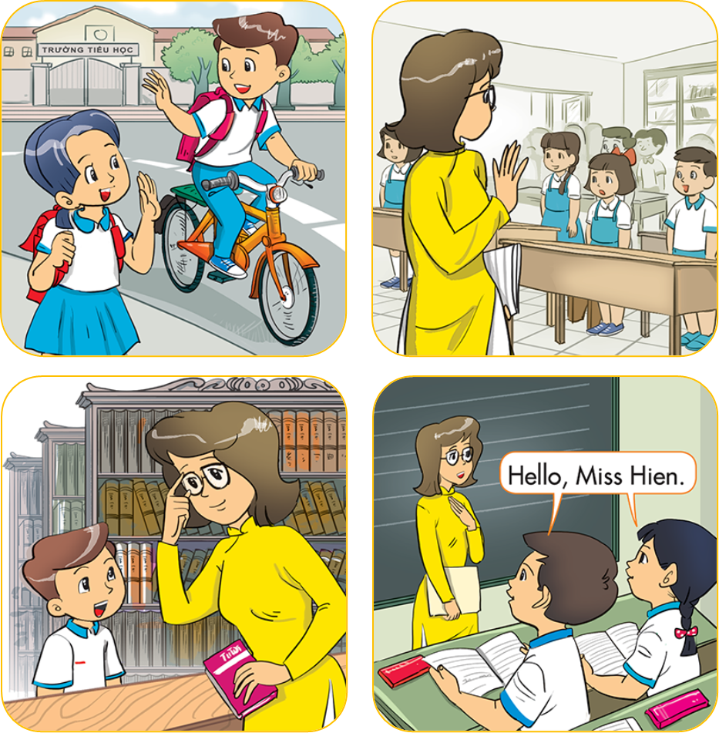
4. Listen and number
1
a
b
2
4
3
3
4
c
d
2
1

Slide 23
5. Read and complete
Miss Hien: Goodbye, class.
Class: (1) __________, Miss Hien.
Mai: Bye, Nam.
Nam: (2) _______________, Mai.
Nam: How are you, Quan?
Quan: (3) ______, thanks. And you?
Nam: Fine, (4) _____________.
1
goodbye
bye
fine
thank you
Goodbye
2
Bye
/ Goodbye
3
Fine
thank you

Slide 24
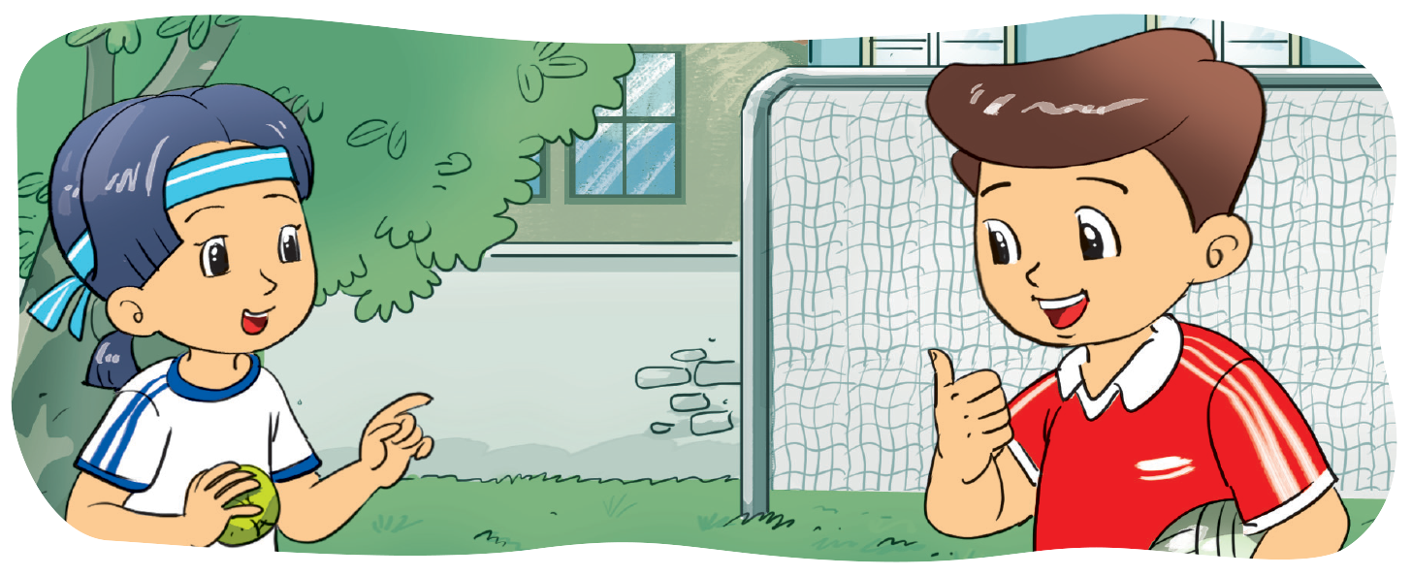
6. Let's write.
_____, ______. And you?
Fine
thanks
_____ are you?
How
Fine, thanks.

Slide 25
New words:
Goodbye/ bye: Tạm biệt
Class: lớp
Fine: tốt, khỏe
Thanks/ thank you: cảm ơn
And: và
II. Structures:
Hỏi và trả lời về sức khỏe:
How are you? ( Bạn có khỏe không?)
I’m fine, thank you. And you?
(Mình khỏe, cảm ơn. Còn bạn thì sao?)
Fine, thanks.
I’m great.
I’m happy.

Slide 26
THANK YOU!
Welcome to join with me!

